Slide 1
Transition from University to Work: Dynamic Relationships between Career Planning, Self-efficacy, and Worry
Anne-Kathrin Kleine, Antje Schmitt, & Anita Keller
University of Groningen

Slide 2
Theoretical Background

Slide 3




Career-related worries during pre-graduation phase:
Insecurity about future employment
(Koen et al., 2012; Leach, 2017)
Labor market myths
(Ball, 2018)
Career construction theory (Savickas, 2005)
Adapting as a process of performing actions that address changing conditions directly
Career planning

Slide 4
Career planning (Gould, 1979)
the extent to which career plans exist,
how frequently career plans are changed,
how clear the plans are, and
whether or not a strategy exists for achieving career goals

Slide 5
H1: Career planning leads to a decrease in career-related worries during the pre-graduation phase
Career planning
Career-related worry
-

Slide 6






Worry affects the temporal focus on outcomes (Worthy et al., 2014)
preference for immediate over delayed rewards
Task avoidance theory (e.g., Ferrari et al., 1995):
(Irrational) fears and self-criticism lead to task avoidance

Slide 7
H2: Career-related worry leads to a decrease in career planning during the pre-graduation phase
Career-related worry
Career planning
-

Slide 8

Career construction theory
(Savickas, 2005)
Career-preparatory actions (adapting) as a source of a sense of mastery
Gaining self-efficacy by engaging in career-preparatory behavior (DelCorso, 2011)

Slide 9
Social cognitive career theory
(e.g., Lent, Brown, and Hackett 1994):
Self-efficacy as a predictor of a person’s engagement in career-preparatory behaviors (e.g., Chung 2002)

Slide 10
H4: Career planning leads to an increase in self-efficacy during the pre-graduation phase
Career planning
Self-efficacy
+
H3: Self-efficacy leads to an increase in career planning during the pre-graduation phase
Self-efficacy
Career planning
+

Slide 11

Self-efficacy diminishes pre-task anxiety (Stumpf et al., 1987), and enhances life satisfaction and positive affect (e.g., Konstam et al., 2015)

Slide 12
H5: Self-efficacy leads to a decrease in career-related worry during the pre-graduation phase
Self-efficacy
Career-related worry
-

Slide 13
The Research Model
Self-efficacy
H3
H5
+
+
-
H4
Career planning
-
H1
Career-related worry
-
H2

Slide 14
Methods

Slide 15

Latent Change Score Modelling (McArdle & Hamagami, 2001; McArdle, 2009)
Detect differences in the patterns of individual changes
Examination of interrelated processes
Change score Δ = Change for one individual from t to t+x
Pre-graduation phase as a phase of change (e.g., triggered by active engagement in career-preparatory behavior)

Slide 16



Sample:
300 British students during the pre-graduation phase
64% female
Mean age = 22.8
27.6% found a job at T2
Measures:
Career planning (Gould 1979)
Self-efficacy (Chen et al., 2001)
Career-related worry (WDQ-R, Rijsoort et al., 1999)
Time points:
T1: Three months before graduation
T2: six weeks before graduation

Slide 17
Results

Slide 18
Reliabilities:
Cronbach’s alpha between .88 (t1 self-efficacy) and .91 (t1 career planning)
CFA:
Best fit for three-factor model
Measurement invariance:
Strong factorial invariance established (change in fit for any of the relevant fit measures < .003)

Slide 19
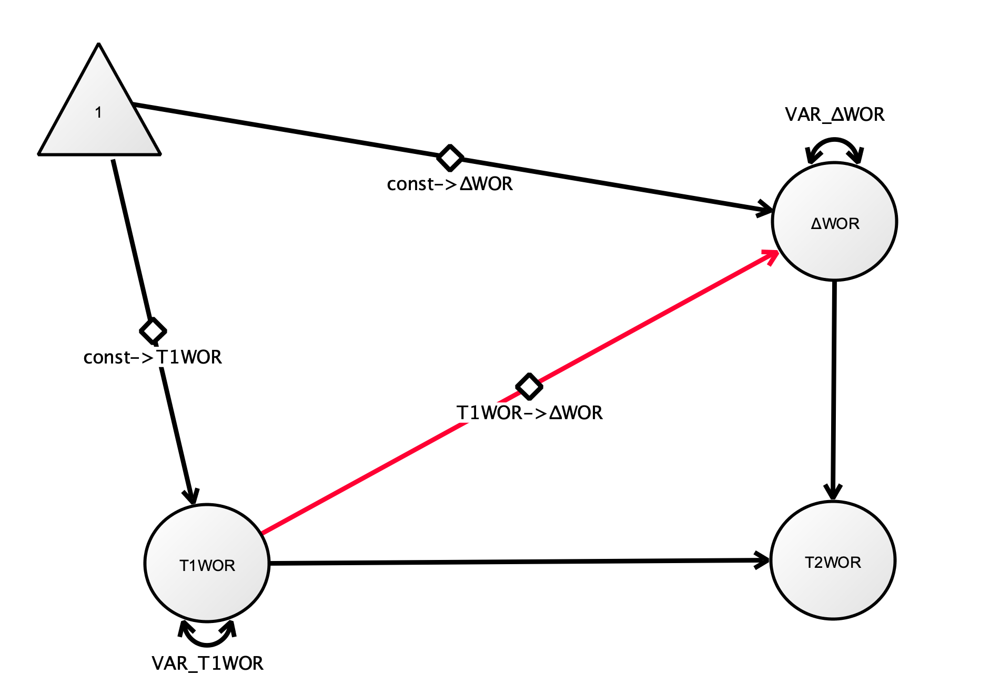

Univariate Latent Change Score Model
 | CPL | SE | WOR
Mean change
Variance of change score
Covariance of initial score with change score
Example Plot: Univariate Latent Change Score Model Worry

Slide 20
Bivariate Latent Change Score Model
Coupling effect
Example Plot: Bivariate Latent Change Score Model Career Planning - Worry

Slide 21
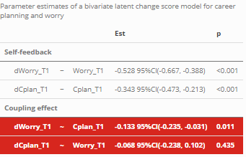
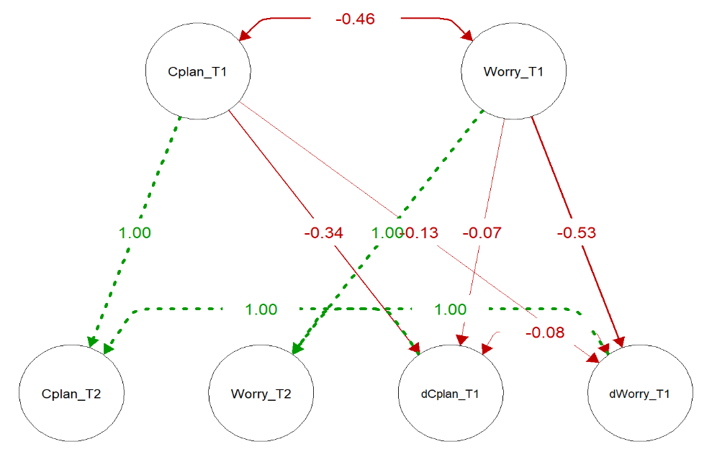
Bivariate Latent Change Score Model Career Planning - Worry
Constraining coupling effect of worry to zero → no change in model fit (p = .436)
Constraining coupling effect of career planning to zero → change in model fit (p = .001)

Slide 22


Career planning
-
H1
Career-related worry
-
H2

Slide 23
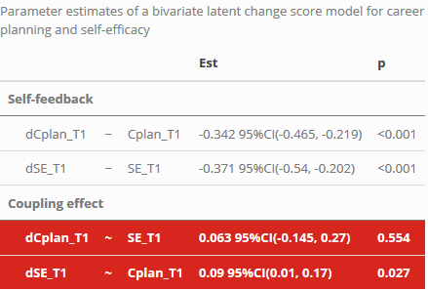
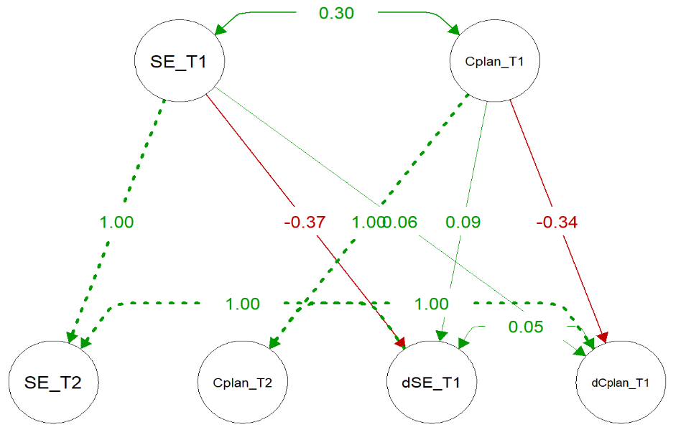
Bivariate Latent Change Score Model Career Planning – Self-efficacy
Constraining coupling effect of self-efficacy to zero → no change in model fit (p = .552)
Constraining coupling effect of career planning to zero → change in model fit (p = .015)

Slide 24
Career planning
+
H3
Self-efficacy
+
H4

Slide 25
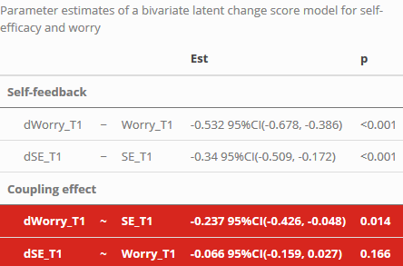
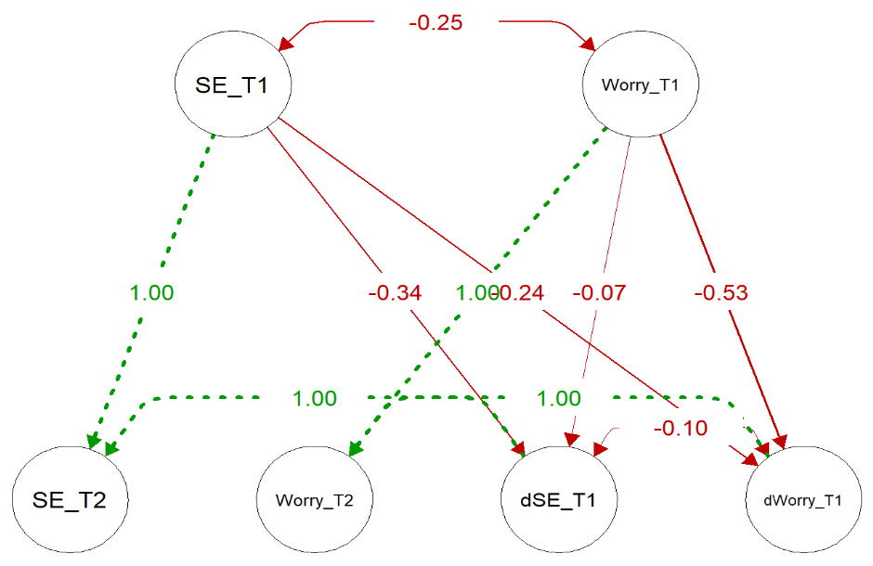
Bivariate Latent Change Score Model Self-efficacy - Worry
Constraining coupling effect of worry to zero → no change in model fit (p = .156)
Constraining coupling effect of self-efficacy to zero → change in model fit (p = .007)

Slide 26
Self-efficacy
Career-related worry
-
H5

Slide 27
The Research Model
Self-efficacy
H4
H5
+
+
-
H3
Career planning
-
H1
Career-related worry
-
H2

Slide 28
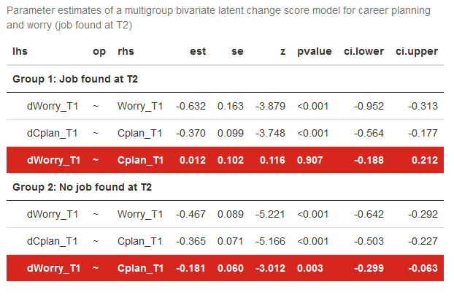
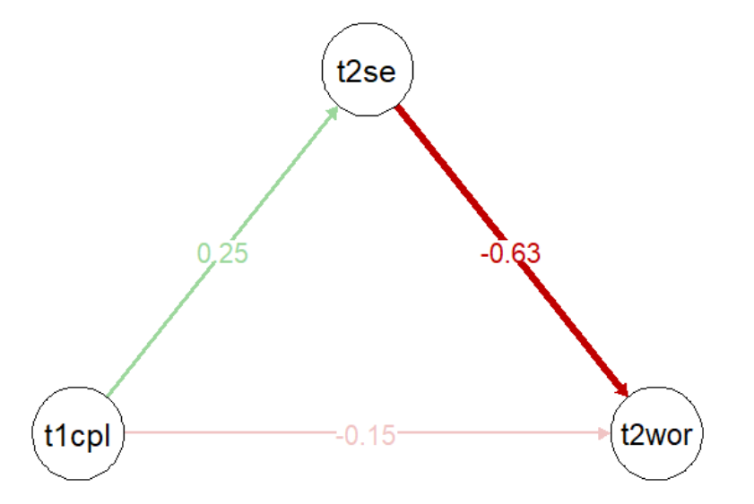
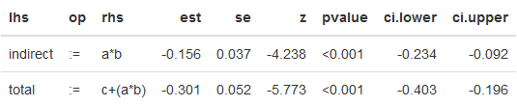
Additional analyses
Multigroup comparison:
Job found at T2 vs. no job found at T2
Mediation analysis

Slide 29
Take home

Slide 30

Take home message
Career planning during the pre-graduation phase positively influences affective (reduced worry) and cognitive (enhanced self-efficacy) outcomes
Career planning as a buffer against uncertainty and worry during pre-graduation phase
Worried graduates do not tend to decrease their level of planning
Self-efficacy seems to convey the effect of career planning on career-related worry

Slide 31
References
Ball, Charlie. 2018. “Graduate labour market myths.” In Graduate Careers in Context - Research, Policy, and Practice, edited by Ciaran Burke and Fiona Christie. Taylor & Francis.
Ballas, D., and D. Dorling. 2007. “Measuring the impact of major life events upon happiness.” International Journal of Epidemiology 36 (6): 1244–52. https://doi.org/10.1093/ije/dym182.
Chen, Gilad, Stanley M. Gully, and Dov Eden. 2001. “Validation of a New General Self-Efficacy Scale.” Organizational Research Methods 4 (1): 62–83. https://doi.org/10.1177/109442810141004.
Chung, Y. B. 2002. “Career Decision-Making Self-Efficacy and Career Commitment: Gender and Ethnic Differences Among College Students.” Journal of Career Development 28: 277–84. https://doi.org/https://doi.org/10.1023/A:1015146122546.
Creed, Peter A., Tracy Fallon, and Michelle Hood. 2009. “The relationship between career adaptability, person and situation variables, and career concerns in young adults.” Journal of Vocational Behavior 74 (2): 219–29. https://doi.org/10.1016/j.jvb.2008.12.004.
Del Corso, Jennifer, and Mark C. Rehfuss. 2011. “The role of narrative in career construction theory.” Journal of Vocational Behavior 79 (2): 334–39. https://doi.org/10.1016/j.jvb.2011.04.003.
Gould, Sam. 1979. “Characteristics of Career Planners in Upwardly Mobile Occupations.” Academy of Management Journal 22 (3): 539–50. https://doi.org/10.5465/255743.
Hirschi, Andreas. 2009. “Career adaptability development in adolescence: Multiple predictors and effect on sense of power and life satisfaction.” Journal of Vocational Behavior 74 (2): 145–55. https://doi.org/10.1016/j.jvb.2009.01.002.
Koen, Jessie, Ute-Christine Klehe, and Annelies E. M. Van Vianen. 2012. “Training career adaptability to facilitate a successful school-to-work transition.” Journal of Vocational Behavior 81 (3): 395–408. https://doi.org/10.1016/j.jvb.2012.10.003.
Konstam, Varda, Selda Celen-Demirtas, Sara Tomek, and Kay Sweeney. 2015. “Career Adaptability and Subjective Well-Being in Unemployed Emerging Adults.” Journal of Career Development 42 (6): 463–77. https://doi.org/10.1177/0894845315575151.
Leach, Tony. 2017. “‘It seems at the moment my career is dependent on factors outside of my control’: reflections on graduates’ experiences of employment and career enactment in an era of economic uncertainty and austerity.” British Journal of Guidance & Counselling 45 (2): 188–98. https://doi.org/10.1080/03069885.2016.1254724.
Lent, Robert W., Steven D. Brown, and Gail Hackett. 1994. “Toward a Unifying Social Cognitive Theory of Career and Academic Interest, Choice, and Performance.” Journal of Vocational Behavior 45 (1): 79–122. https://doi.org/10.1006/jvbe.1994.1027.
Ng, Thomas W. H., Lillian T. Eby, Kelly L. Sorensen, and Daniel C. Feldman. 2005. “PREDICTORS OF OBJECTIVE AND SUBJECTIVE CAREER SUCCESS: A META-ANALYSIS.” Personnel Psychology 58 (2): 367–408. https://doi.org/10.1111/j.1744-6570.2005.00515.x.
Rijsoort, Stella van, Paul Emmelkamp, and Geert Vervaeke. 1999. “The Penn State Worry Questionnaire and the Worry Domains Questionnaire: structure, reliability and validity.” Clinical Psychology & Psychotherapy 6 (4): 297–307. https://doi.org/10.1002/(SICI)1099-0879(199910)6:4<297::AID-CPP206>3.0.CO;2-E.
Savickas, Mark L. 2005. “The theory and practice of career construction.” In Career Development and Counseling: Putting Theory and Research to Work, edited by Steven D Brown and Robert W Lent, 42–70. New Jersey: John Wiley & Sons.
Skorikov, Vladimir. 2007. “Continuity in adolescent career preparation and its effects on adjustment.” Journal of Vocational Behavior 70 (1): 8–24. https://doi.org/10.1016/j.jvb.2006.04.007.
Stumpf, Stephen A, Arthur P Brief, and Karen Hartman. 1987. “Self-efficacy expectations and coping with career-related events.” Journal of Vocational Behavior 31 (1): 91–108. https://doi.org/10.1016/0001-8791(87)90037-6.
Worthy, Darrell A., Kaileigh A. Byrne, and Sherecce Fields. 2014. “Effects of emotion on prospection during decision-making.” Frontiers in Psychology 5 (June). https://doi.org/10.3389/fpsyg.2014.00591.

Slide 32
R Code and Presentation
You may access the R code and the presentation via
https://github.com/fastnotfurious/SGM_Amsterdam_Mar20

Slide 33
Appendix

Slide 34
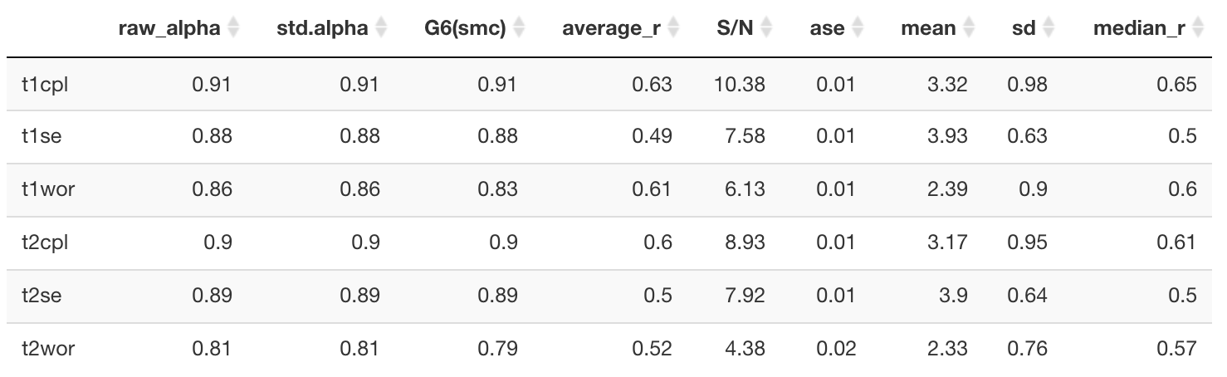
Reliabilities

Slide 35
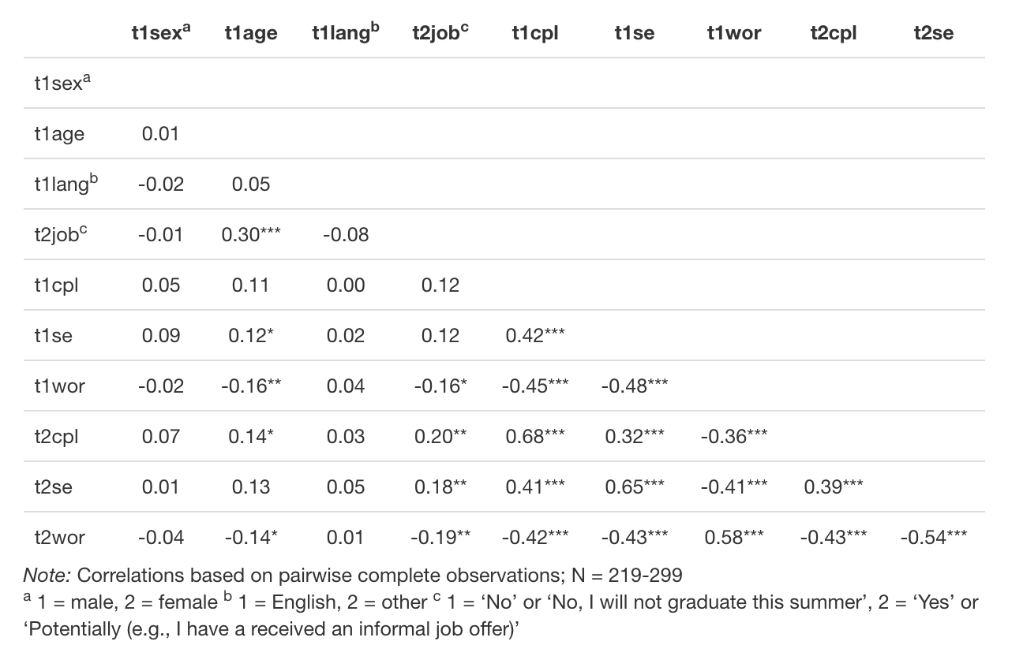
Correlations

Slide 36
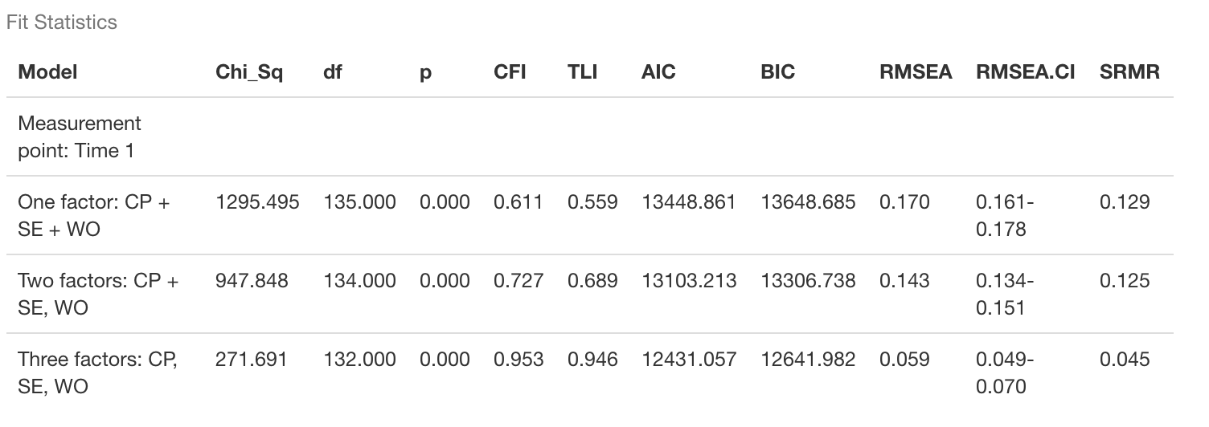
Confirmatory Factor Analyses
Model comparison: One versus two versus three factors

Slide 37
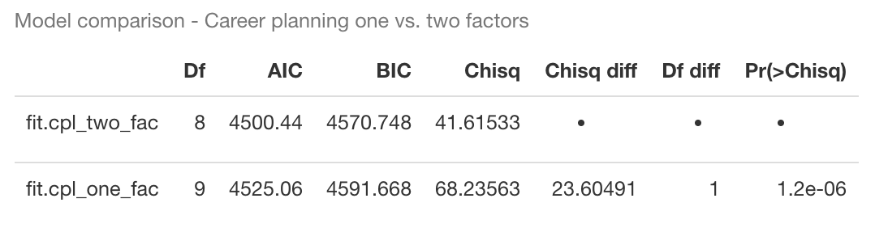
Confirmatory Factor Analyses
“I have not really decided what my career objectives should be yet.” (reverse): Decidedness
“I have a plan for my career.”: Strategy
“I have a strategy for achieving my career goals.”: Strategy
“I know what I need to do to reach my career goals.”: Strategy
“My career objectives are not clear.” (reverse): Decidedness
“I change my career objectives frequently.” (reverse): Decidedness

Slide 38
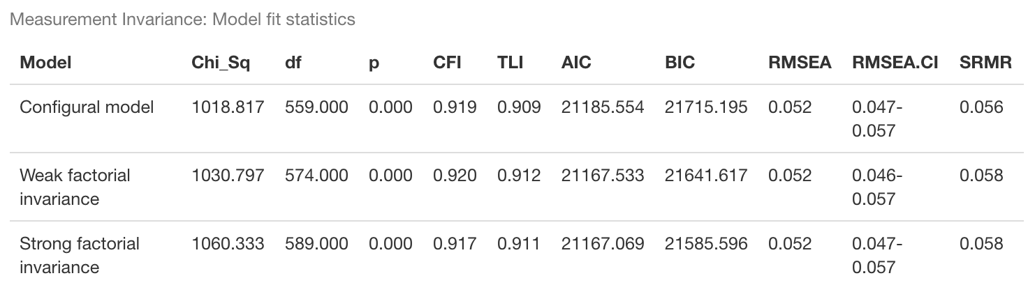
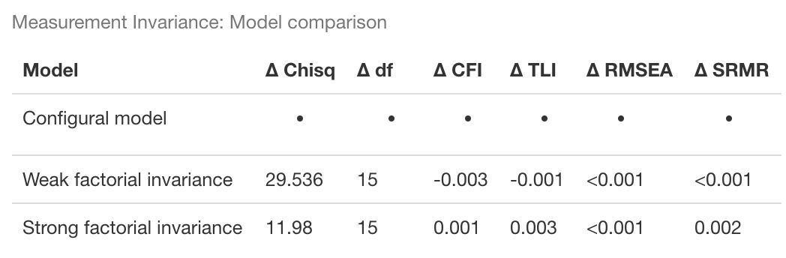
Measurement Invariance

Slide 39
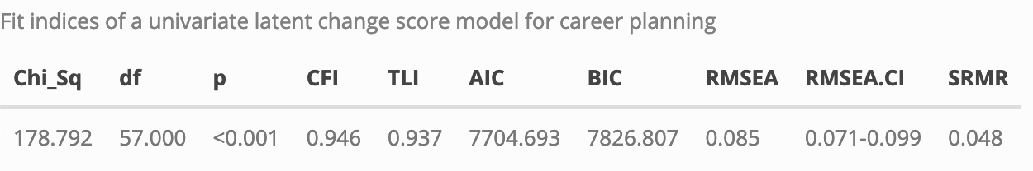
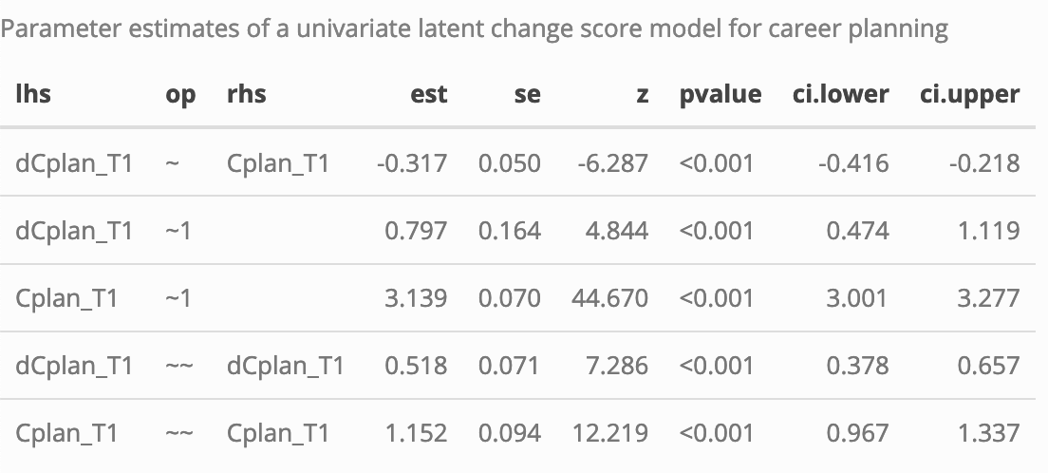
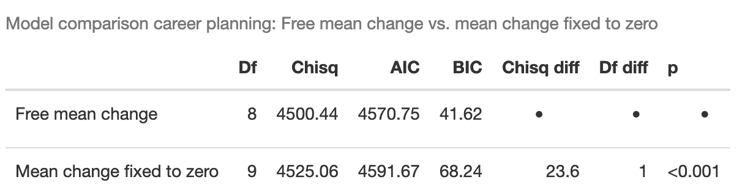
Univariate Latent Change Score Model Career Planning
Overall model fit
Covariance between initial score and change score
Variance change score
Mean change

Slide 40
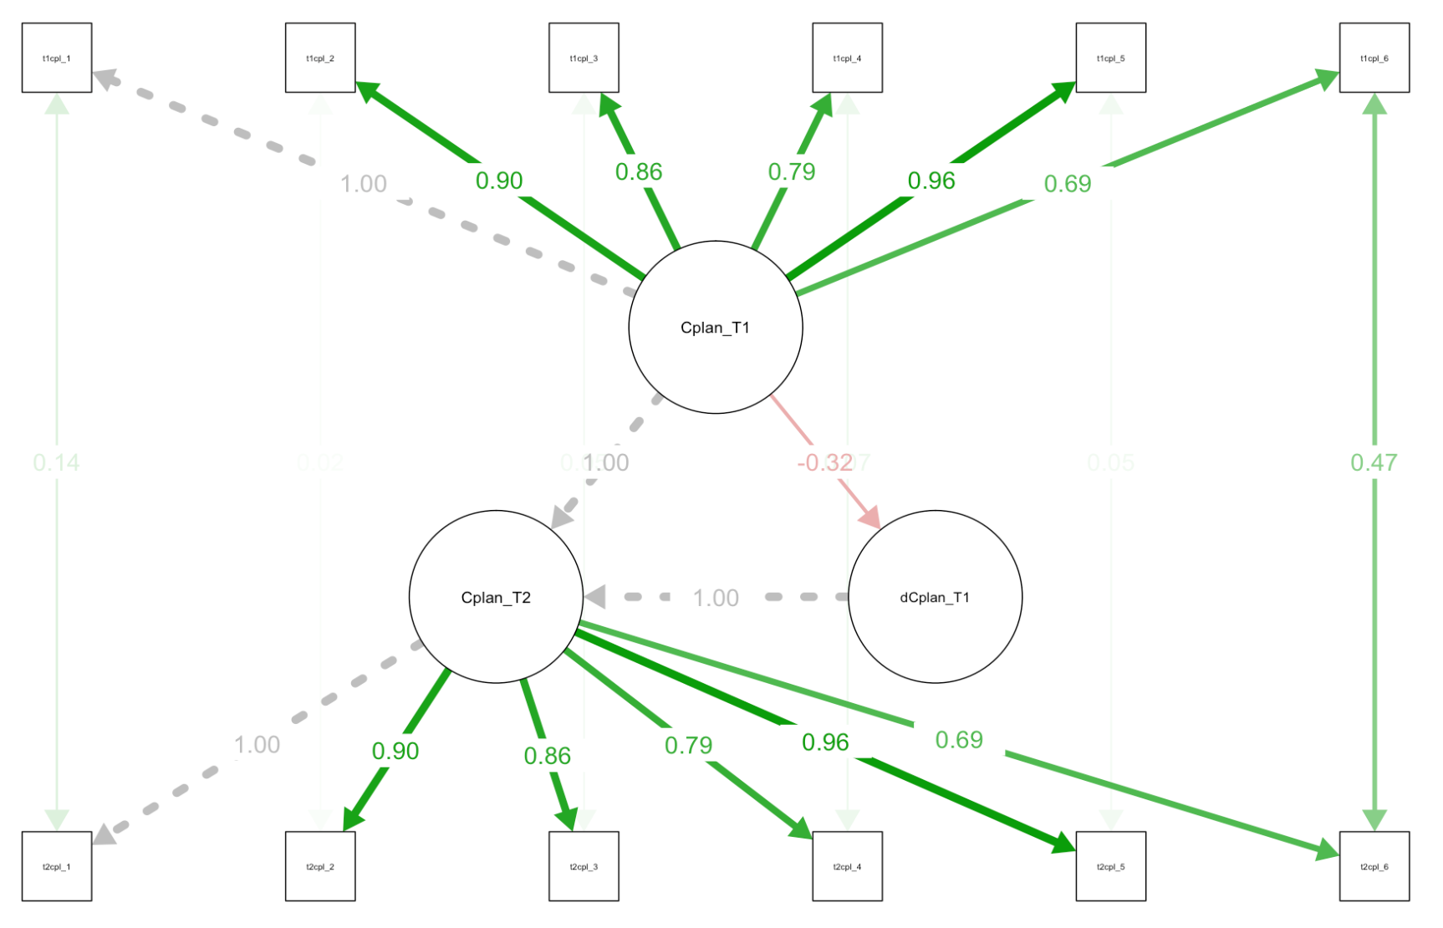
Univariate Latent Change Score Model Career Planning

Slide 41
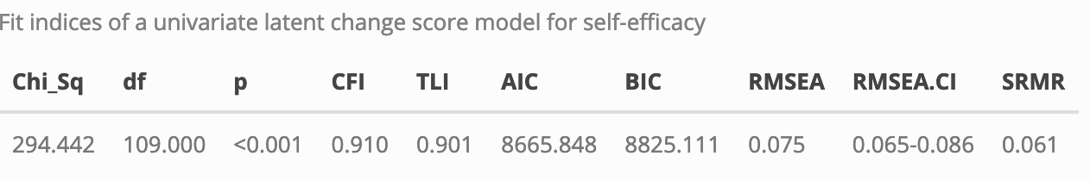
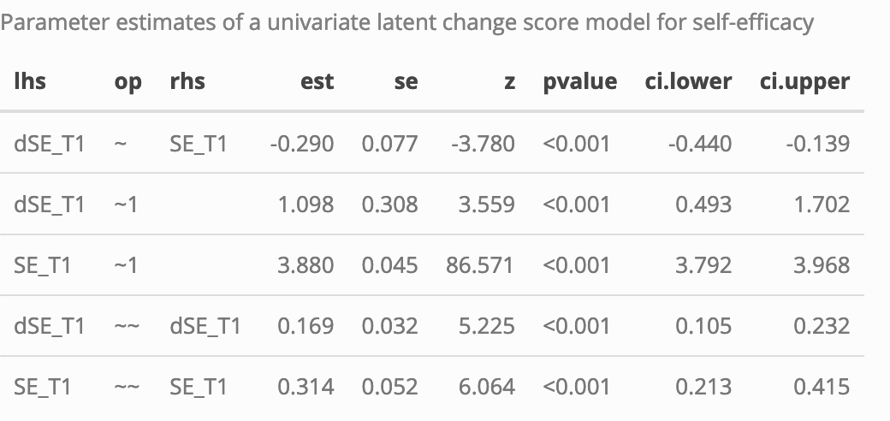
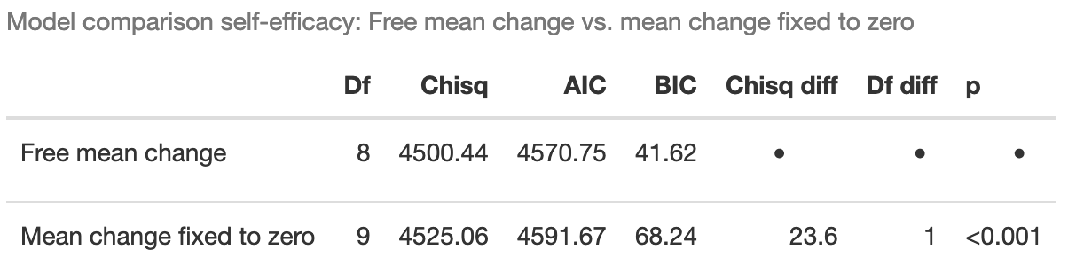
Univariate Latent Change Score Model Self-efficacy

Slide 42
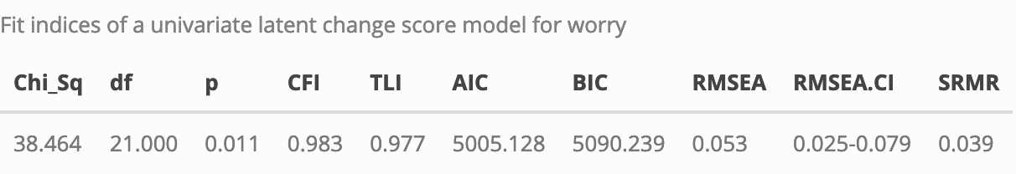
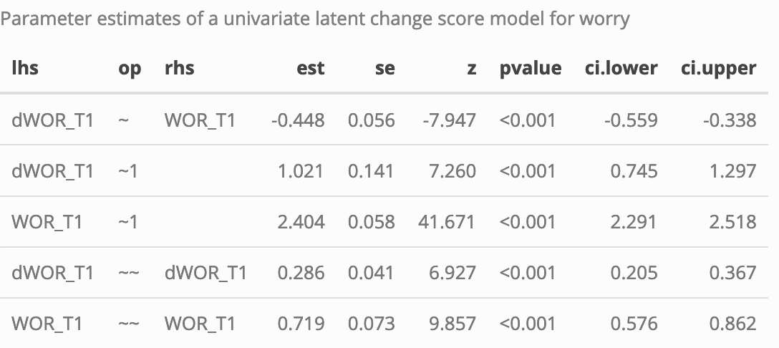
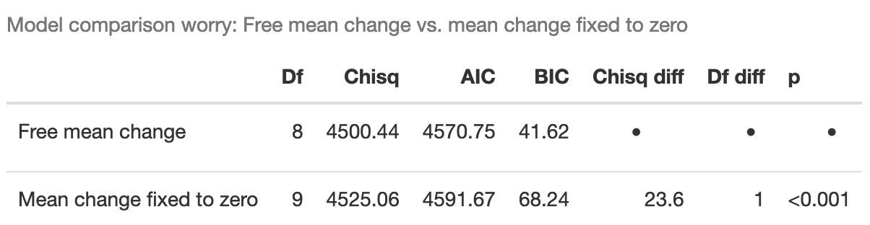
Univariate Latent Change Score Model Career-related Worry

Slide 43
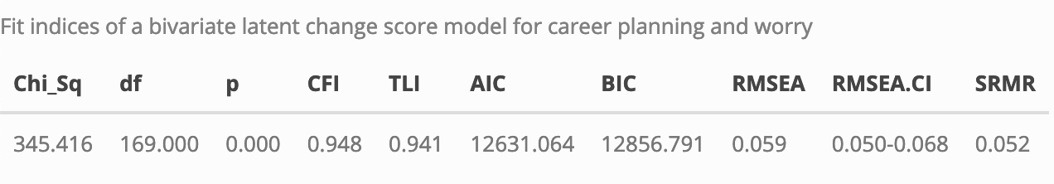
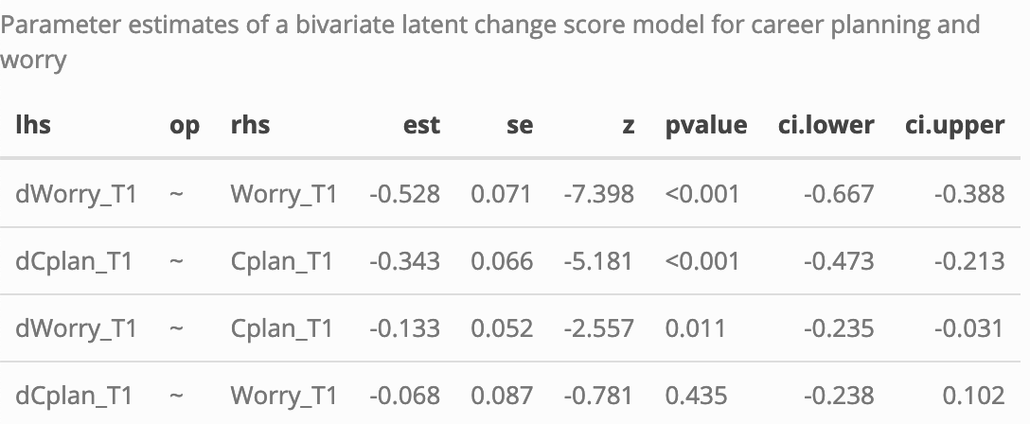
Bivariate Latent Change Score Model Career Planning - Worry

Slide 44
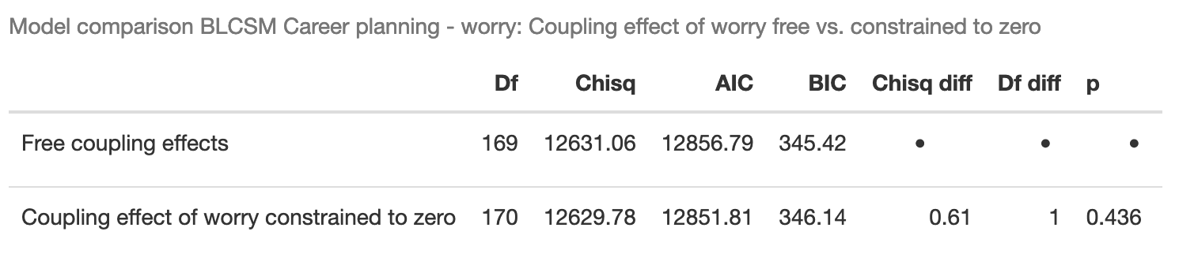
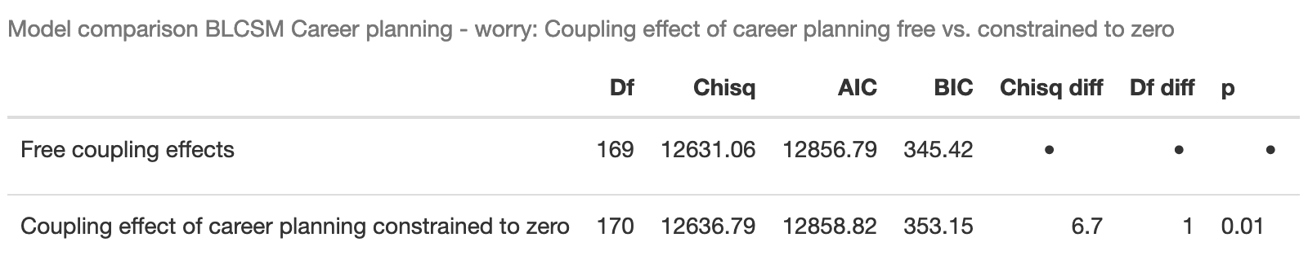
Bivariate Latent Change Score Model Career Planning - Worry
Model comparison: Coupling parameters constrained to zero
H1
H2

Slide 45
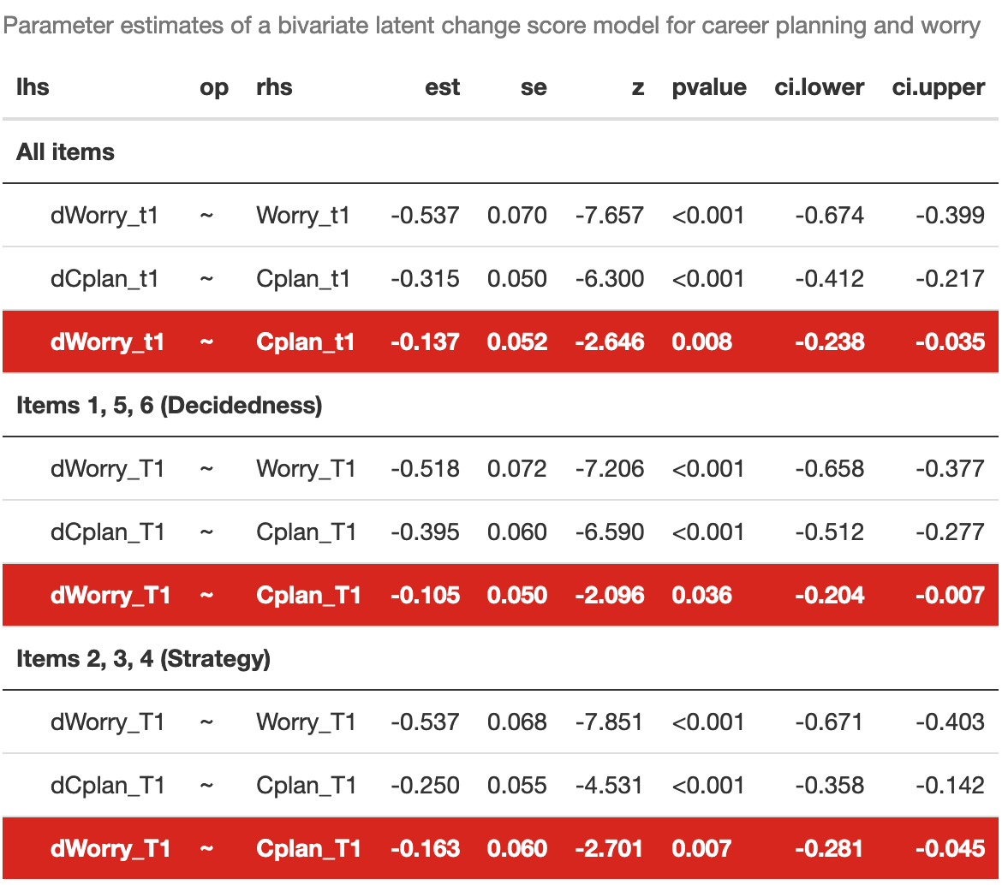
Bivariate Latent Change Score Model Career Planning - Worry
“I have not really decided what my career objectives should be yet.” (reverse): Decidedness
“I have a plan for my career.”: Strategy
“I have a strategy for achieving my career goals.”: Strategy
“I know what I need to do to reach my career goals.”: Strategy
“My career objectives are not clear.” (reverse): Decidedness
“I change my career objectives frequently.” (reverse): Decidedness

Slide 46
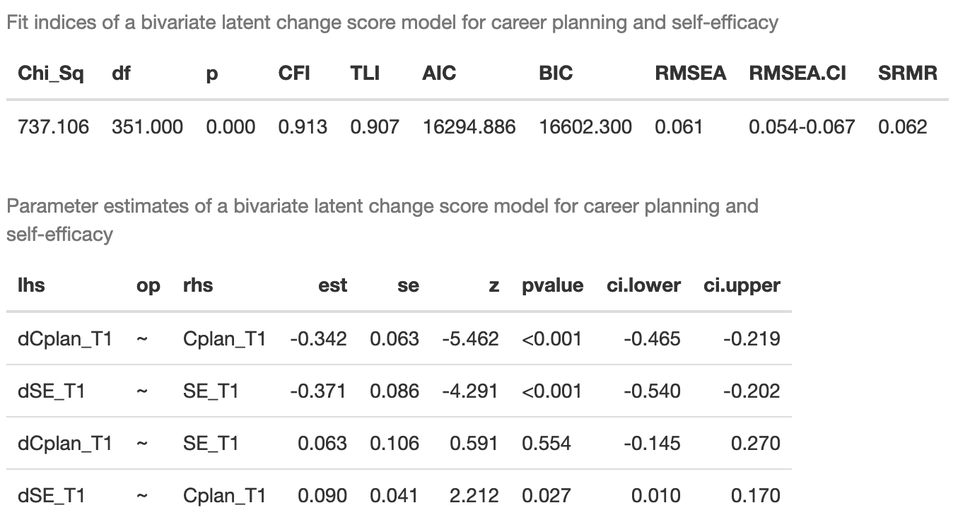
Bivariate Latent Change Score Model Career Planning – Self-efficacy

Slide 47
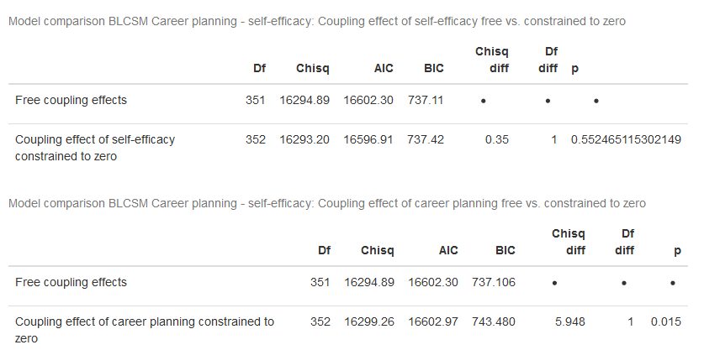
Bivariate Latent Change Score Model Career Planning – Self-efficacy
Model comparison: Coupling parameters constrained to zero
H3
H4

Slide 48
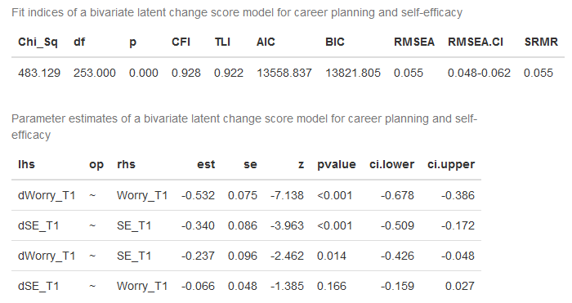
Bivariate Latent Change Score Model Self-efficacy – Worry

Slide 49
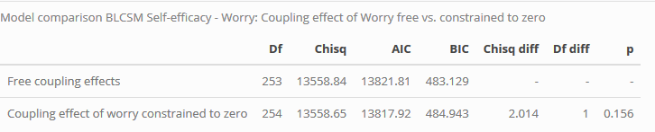
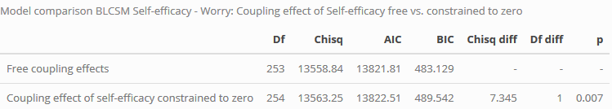
Bivariate Latent Change Score Model Self-efficacy - Worry
Model comparison: Coupling parameters constrained to zero
H5

Slide 50

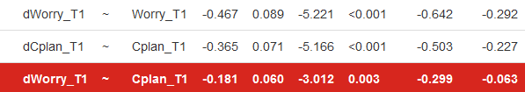
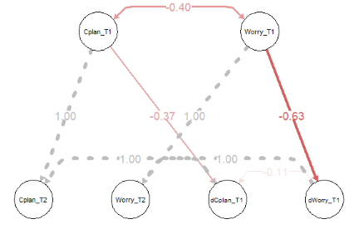
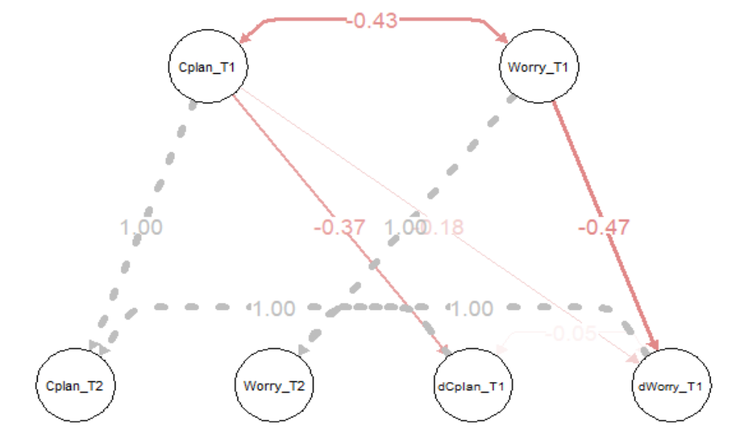
Multigroup Bivariate Latent Change Score Model Career-planning – Worry
Job found at T2 (Group 1) vs. no job found at T2 (Group 2)

Slide 51
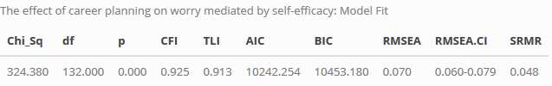
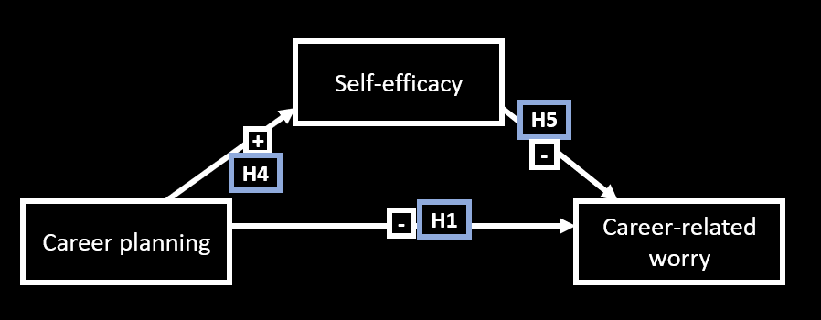
The effect of career planning on worry mediated by self-efficacy

